Slide 1
Harder, better, faster, stronger !
A story about high-performance JavaScript
Florian Simon – github.com/floriansimon1

Slide 2

We build:
Full-stack JavaScript applications
Unix infrastructure as code
… all of it on top of FLOSS
We’re looking for talented developers – always ;)
jobs.tentwentyfour.lu
Notes:
My boss made me include this

Slide 3
Introduction
The application
The performance problem
Finding bottlenecks
Optimization techniques
Proceed with caution
Quiz!

Slide 4
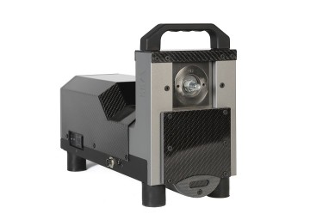
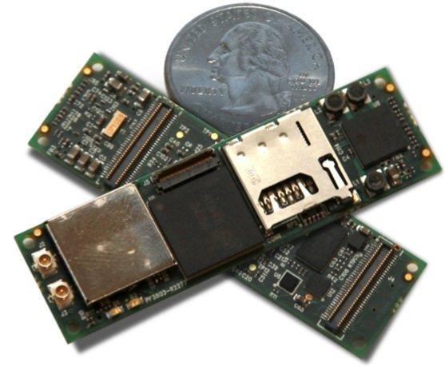
About the application (1/2)
Notes:
Machine that vibrates to test resistance of fasteners to vibration Runs Node JS on a small embedded Linux computer
Serves a web application that communicates with the machine via WebSockets

Slide 5
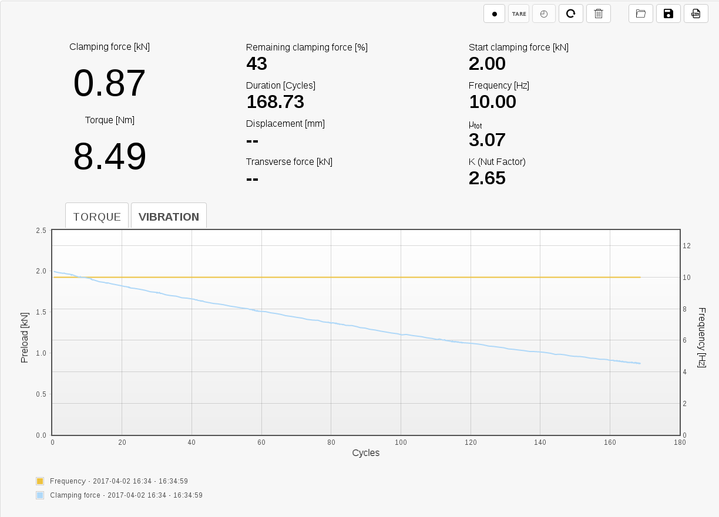
About the application (2/2)
Notes:
While the machine vibrates, sensors measure values that are plotted on a graph

Slide 6
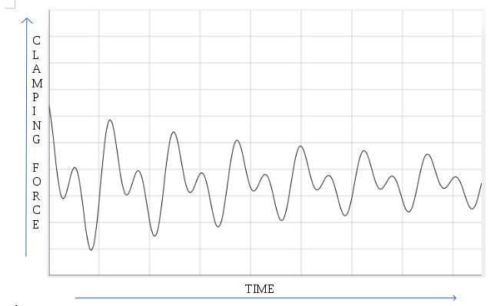
The performance problem (1/4)
Notes:
This is the physical phenomenon. Period is one motor rotation cycle

Slide 7
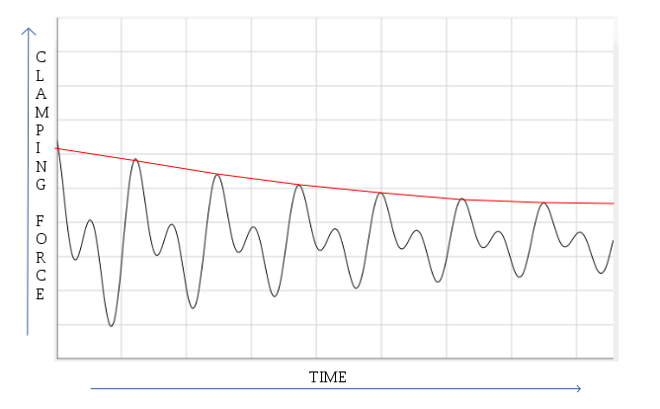
The performance problem (2/4)
Notes:
The red line is what our customer wants to see on the graph

Slide 8
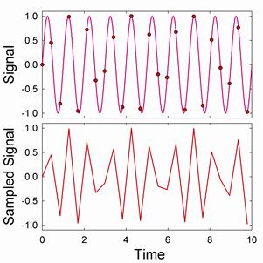
The performance problem (3/4)
Notes:
Red lines obtained by reading the maximum value for every period, but we don’t have them sometimes, because the system cannot perform measurements at the right sample rate.

Slide 9
The performance problem (4/4)
Memory usage is OK in my case
My problem is CPU usage, which is maxed out

Slide 10
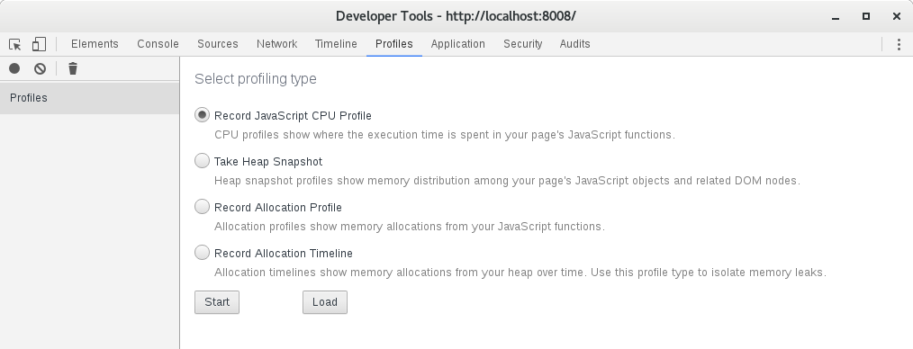
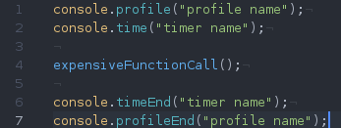
Finding bottlenecks (1/5)
Notes:
Also available for NodeJS 6+ with the --inspect command line argument

Slide 11
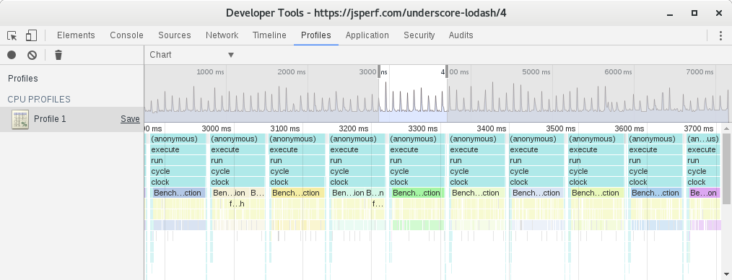
Finding bottlenecks (2/5)

Slide 12
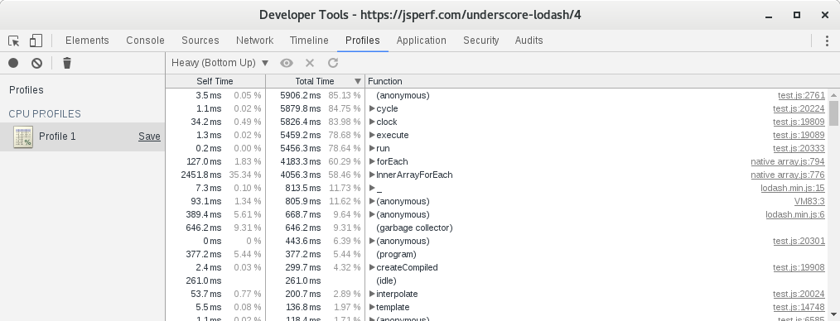
Finding bottlenecks (3/5)

Slide 13
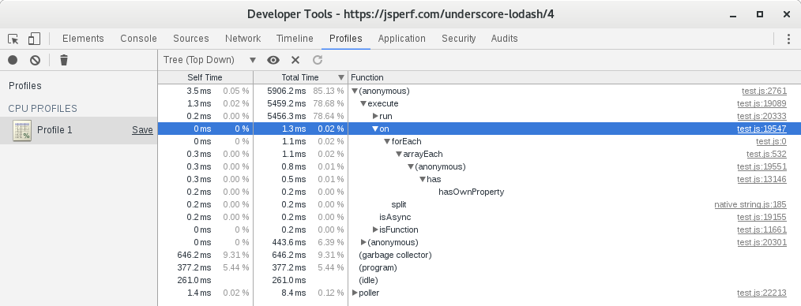
Finding bottlenecks (4/5)
Notes:
Self = time executing the instruction of a function
Total = that + time of child calls

Slide 14
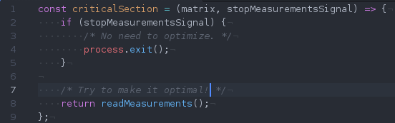
Finding bottlenecks (5/5)
When optimizing, try to have profiles before and after the modification, because results can be surprising
Careful! Numbers can be different in two profiles of the same code.
Know where to optimize
Notes:
For a change to be an optimization, the difference must be significant
Optimizations might not be optimizations across platforms

Slide 15
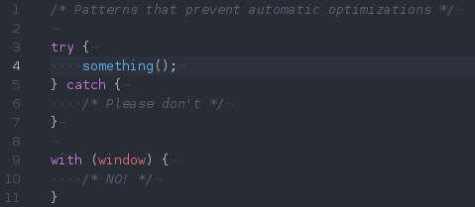
Optimization techniques (1/9)

Slide 16
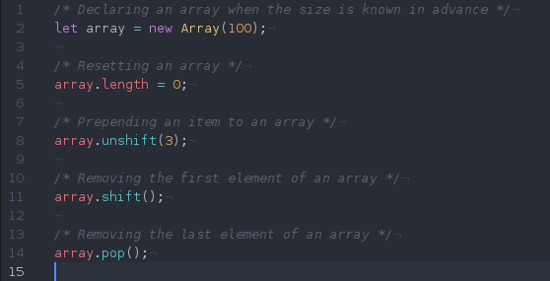
Optimization techniques (2/9)

Slide 17
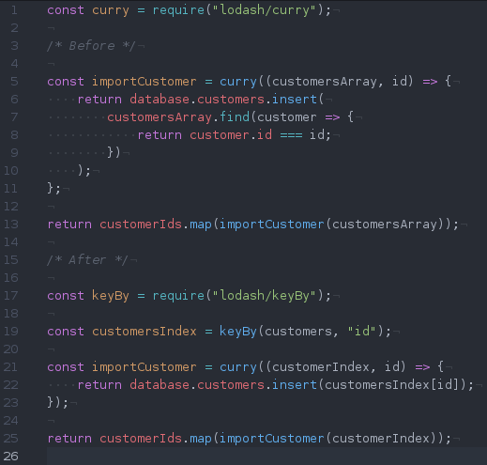
Optimization techniques (3/9)

Slide 18
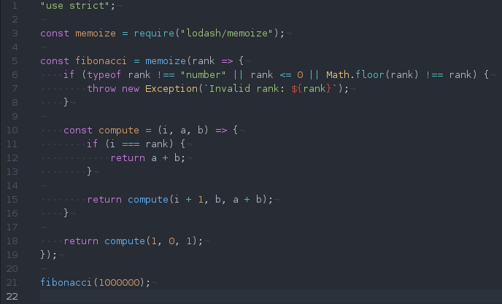
Optimization techniques (4/9)
Notes:
Memoize: https://lodash.com/docs#memoize
Tail call recursion: http://stackoverflow.com/questions/310974/what-is-tail-call-optimization + https://kangax.github.io/compat-table/es6/

Slide 19
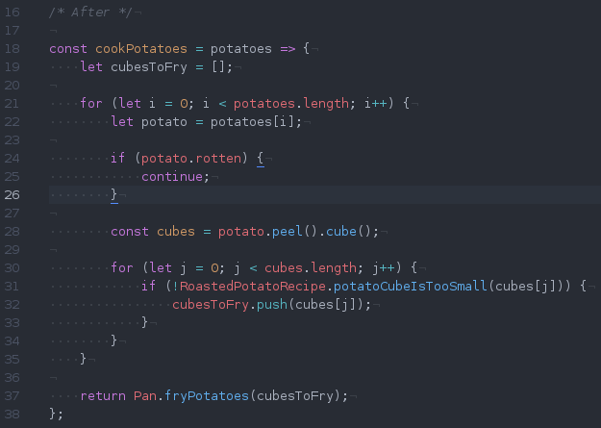
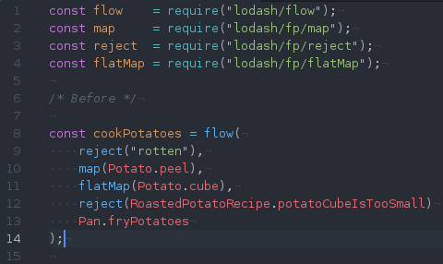
Optimization techniques (5/9)
Notes:
Function calls are expensive

Slide 20
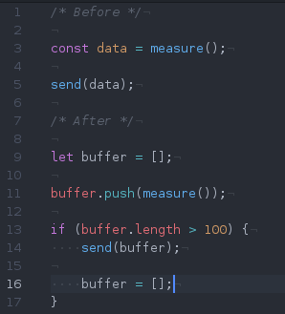
Optimization techniques (6/9)
Before: send measurements sample by sample
After: send by chunks
Why: websockets overhead!

Slide 21
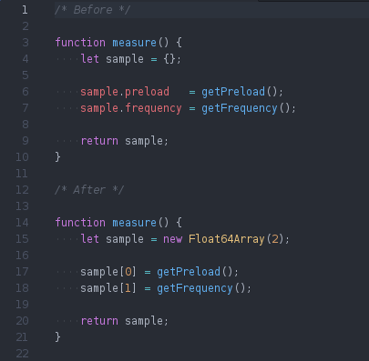
Optimization techniques (7/9)
Before: samples encoded as JS objects
After: use TypedArrays
Why: compact memory footprint, avoid JSON (de)serialization
Keeping it readable: use classes!

Slide 22
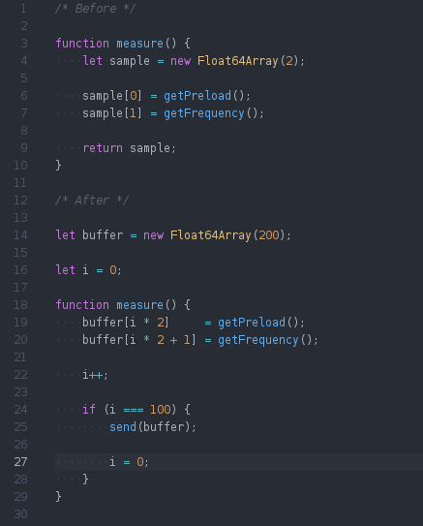
Optimization techniques (8/9)
Before: allocate data buffer in every measurements cycle
After: preallocate data containers
Why: no more garbage collection, allocate only once

Slide 23
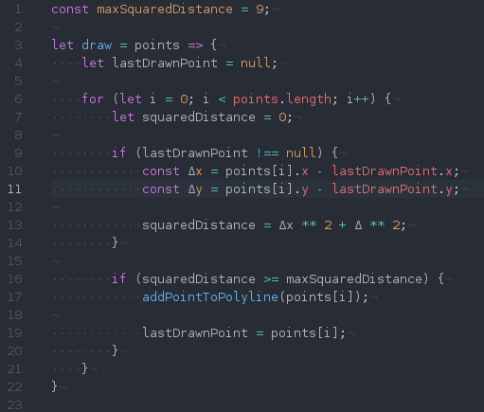
Optimization techniques (9/9)
Before: draw 100k points every 800 ms
After: only draw those points when they are spaced by at least 3px
Why: I wish I knew...

Slide 24
Proceed with caution ! (1/2)
“Programmers waste enormous amounts of time thinking about, or worrying about, the speed of noncritical parts of their programs, and these attempts at efficiency actually have a strong negative impact when debugging and maintenance are considered. We should forget about small efficiencies, say about 97% of the time: premature optimization is the root of all evil. Yet we should not pass up our opportunities in that critical 3%.”
Donald Knuth (emphasis mine)

Slide 25
Proceed with caution ! (2/2)
“Programs must be written for people to read, and only incidentally for machines to execute”
Harold “Hal” Abelson (emphasis mine)

Slide 26
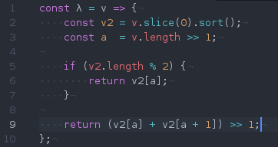
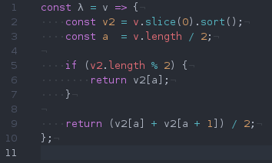
Quiz
VS
Notes:
I was wrong: it turns out that right shifting is actually not optimized according to those jsperfs: https://jsperf.com/division-vs-bit-right-shift/2 Still would avoid it though, because the intent is not clear
I forgot a Math.floor in the definition of a on the right code snippet

Slide 27
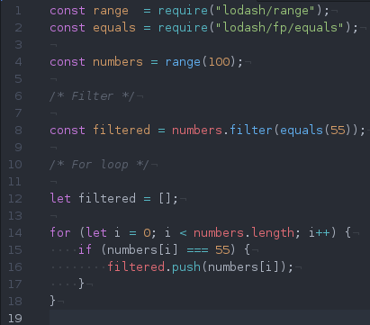
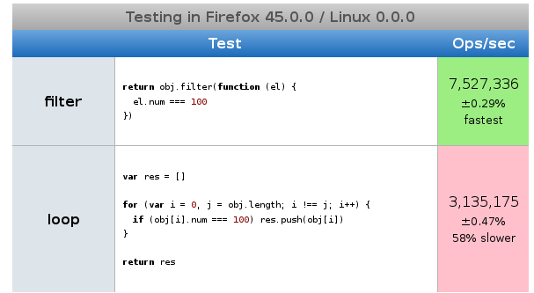
Quiz

Slide 28
More info on this project
https://www.tentwentyfour.lu/projects/node-overo/

Slide 29
THE END
Florian Simon <florian@tentwentyfour.lu>

